Slide 1
Unsupervised clustering and classification of breast cancer using TCGA RNA-seq gene expression data
Zaki Alam
Anuran Samantha
Kundan Kumar
Jatin Arya
Saahil Gupta
Mohit J

Slide 2
Introduction
Background
Transcriptomic analysis studies genome-wide gene expression patterns.
Utilizes techniques like RNA-sequencing or microarrays.
Produces gene expression matrices that map genes (rows) to samples (columns).
Aids in understanding molecular mechanisms behind diseases, drug responses and cellular states.
Dataset Description
We analyze a gene expression dataset with 6,150 genes measured across 526 samples.
Each sample represents a unique biological condition or subject.
Data sourced from a public repository.
Pre-processing steps included: Removal of missing values and Normalization (likely log-transformed expression values).
Notes:
Background:
Samples from 526 samples, each having levels of 6023 attributes or genes.
Each gene’s transcriptomic analysis, like mrna levels to measure gene expression was

Slide 3
Data Acquisition & Preprocessing
Data Source
The raw data was obtained from a public repository in the .cct format, containing gene expression matrices for 526 biological samples and 6150 genes.
No associated metadata (such as clinical information or condition labels) was provided. Hence analyses focus on unsupervised structure discovery (e.g., clustering).
Data Cleaning & Preprocessing
Data Loading: Imported the .cct file and parsed it into a structured format with genes as rows and samples
as columns.
Header Correction: The first few entries included non-numeric identifiers (sample IDs) that were separated.
Missing Value Handling: Genes with missing expression values across any sample were removed.
Data Standardization: Gene expression values were standardized (zero mean and unit variance) to ensure equal weighting across features during PCA and clustering

Slide 4
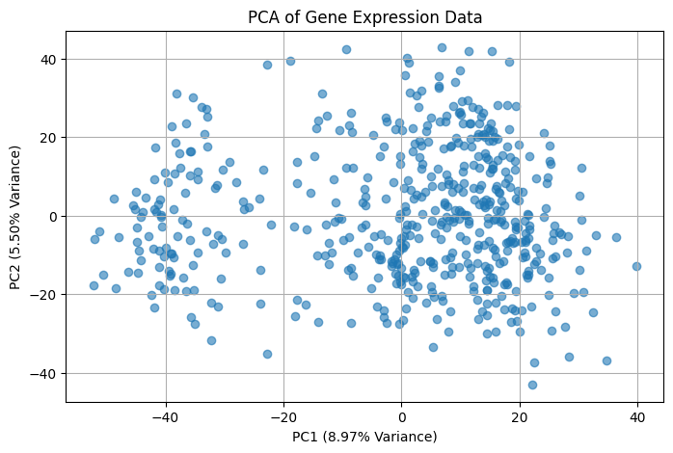
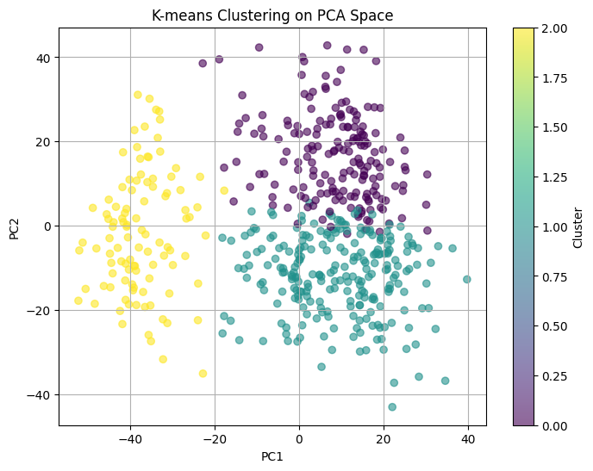
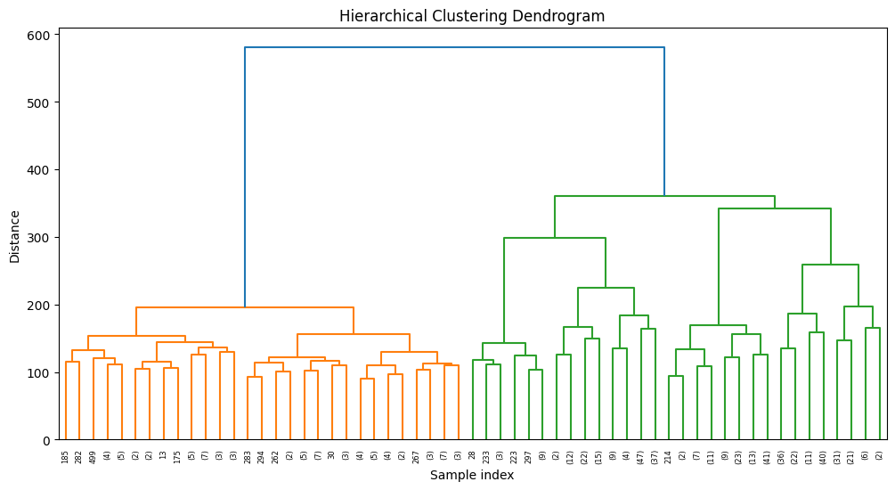
Methods
Principal Component Analysis (PCA)
Methodology: PCA reduces the high-dimensional gene expression data into two principal components, allowing visualization of major patterns and structures in the data.
Clustering (K-means and Hierarchical Clustering)
Methodology: Identify groups of samples based on similarity in gene expression profiles.

Slide 5
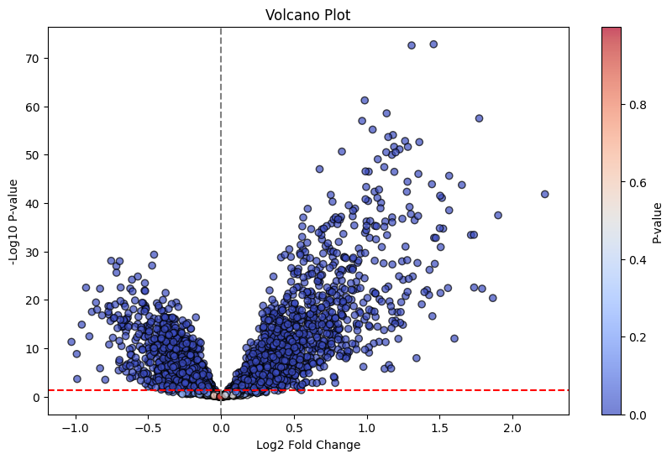
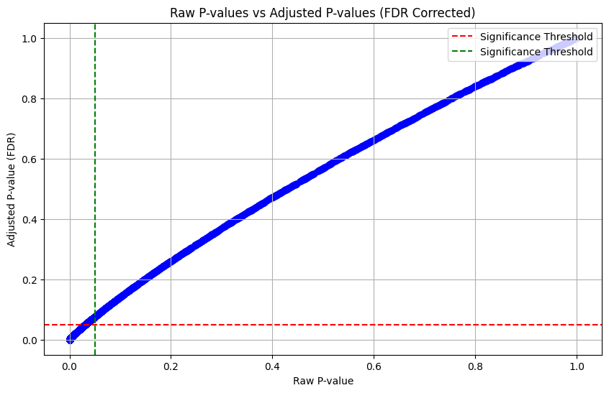
Methods
Differential Expression Analysis
Methodology: Statistical hypothesis testing (e.g., t-test) to find genes differentially expressed between two clusters.
FDR Correction (Benjamini-Hochberg)
Methodology: Correct for multiple testing to control the false discovery rate.

Slide 6
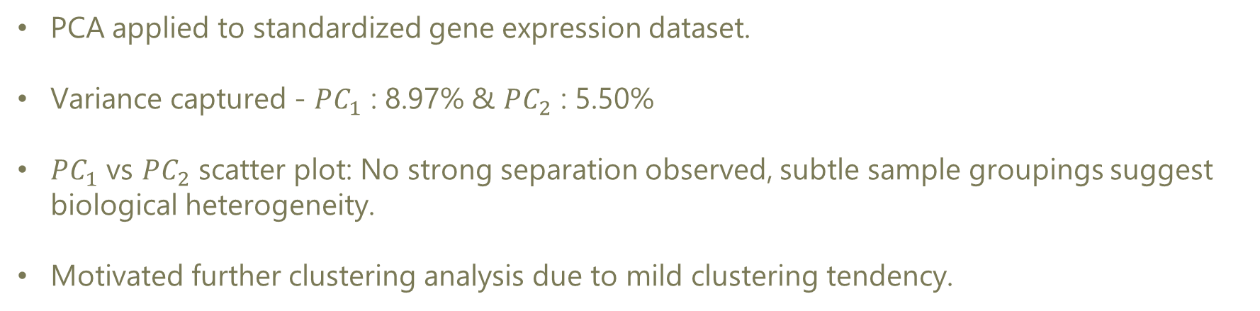
Results & Interpretation
PCA Results Interpretation
PCA applied to standardized gene expression dataset.
Variance captured - $PC_{1}$ : 8.97% & $PC_{2}$ : 5.50%
$PC_{1}$ vs $PC_{2}$ scatter plot: No strong separation observed, subtle sample groupings suggest biological heterogeneity.
Motivated further clustering analysis due to mild clustering tendency.
Cluster Analysis Interpretation
K-means and hierarchical clustering applied.
Revealed potential biological subgroups among samples.

Slide 7
Results & Interpretation
Differential Gene Expression (DEG) Analysis
Hypothesis-driven comparison between two major K-means clusters.
Two-sample T-test performed gene-by-gene (Cluster 0 vs Cluster 1).
Multiple testing corrected using Benjamini-Hochberg FDR method.
Significant DEGs identified (adjusted p < 0.05)
DEGs may underlie biological differences between clusters.
Further validation needed (e.g., pathway enrichment, known markers)

Slide 8
Conclusion & Discussion
Summary of Findings
Analysed large-scale transcriptomics dataset: 6,150 genes across 526 samples.
PCA revealed moderate variance in first two components (~14.5% combined).
K-means clustering identified three distinct sample groups, supported by hierarchical clustering.
Differential expression analysis between major clusters revealed significant DEGs after FDR correction.
Results indicate meaningful biological heterogeneity among samples.

Slide 9
Conclusion & Discussion
Biological Interpretation
No external metadata available (e.g., disease state, age, condition).
Unsupervised clustering and DEG analysis revealed distinct patterns, possibly reflecting: Different biological states (e.g., disease subtypes, treatment responses) and Technical batch effects or sample quality differences.
Identified DEGs may serve as potential marker genes for sample subpopulations.
Further experimental validation and metadata integration needed to confirm biological relevance.

Slide 10
Conclusion & Discussion
Limitations
Absence of Metadata: Limits interpretation of clusters and DEG results.
Assumption of K-means Clusters: Arbitrarily chosen k=3; better methods (e.g., silhouette score) could optimize k
Simple T-test for DEG: More advanced models (e.g., limma-voom) could offer deeper insights.
No Pathway Enrichment: Pathway analysis not performed due to lack of biological labels, but can be explored in future work

